Slide 1

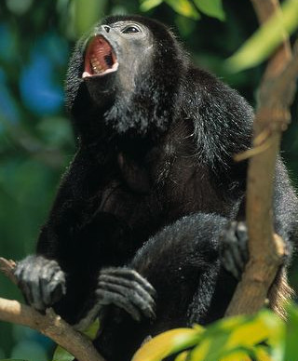

Slide 2
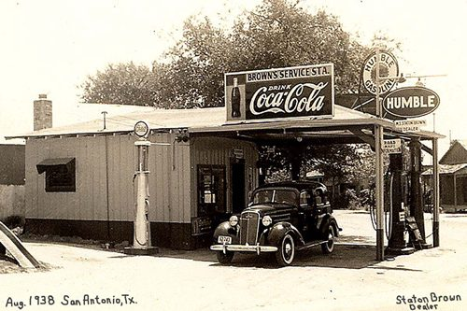

Slide 3
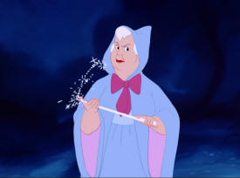

Slide 4
A of variety baits can be used on the mouse trip
peanut butter
Use creamy, not crunchy
Cheese wiz or easy-cheese
Dry cat food

